Slide 1
Flatiron Project 3
Analyzing the effects of price discounts

Slide 2
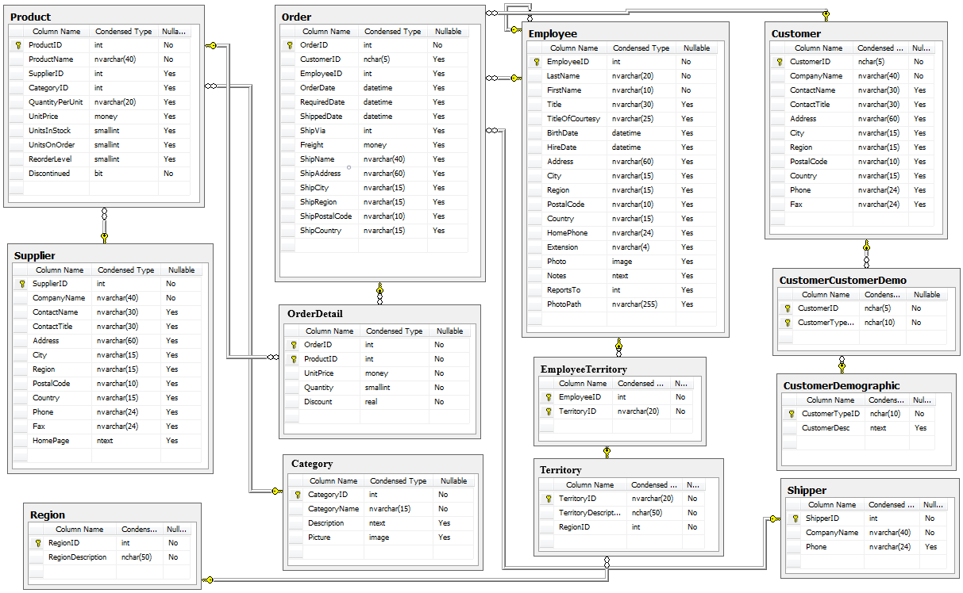
The Northwind database
Several tables show the entire supply chain: items sold, customer orders, supplier details, etc

Slide 3
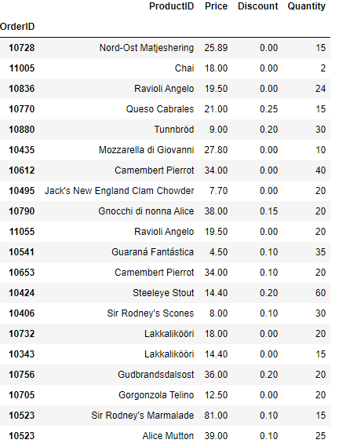
Sample from the orders
Here are 20 randomly selected orders from the database, showing the order ID number, the product name, the discount amount given, and the quantity ordered. We can see that all the items are foodstuffs.

Slide 4
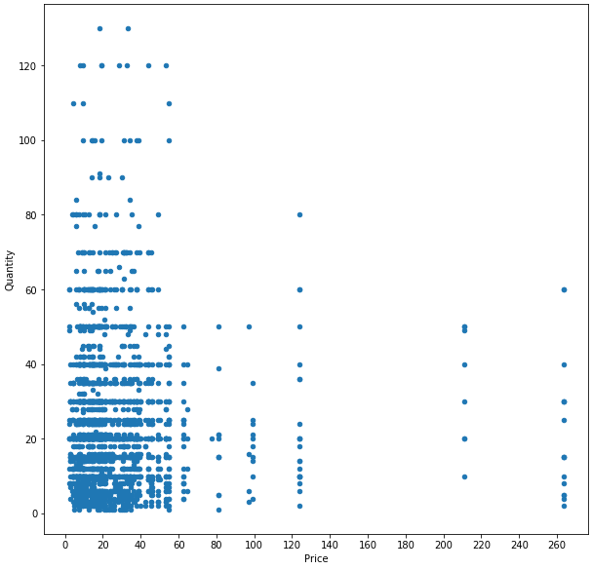
Price vs Quantity
This scatterplot of quantity per order vs price clearly shows that there is a difference between low and high priced items. The cutoff appears to be $70. High priced items are ordered less frequently, and at lower quantities.

Slide 5
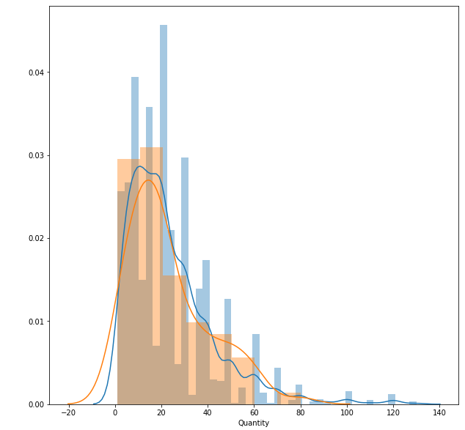
Histogram of high vs low prices
Q1: Does price affect quantity ordered?
A1: Perhaps not, the histograms of both groups seem quite similar. The p-value of the t-test is .78, meaning we cannot assume base price has a significant affect on quantity.

Slide 6
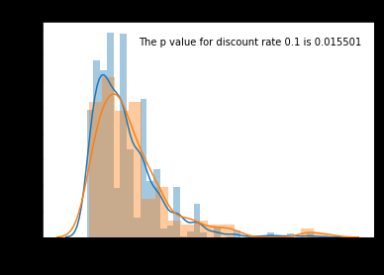
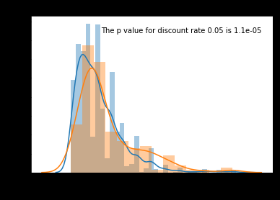
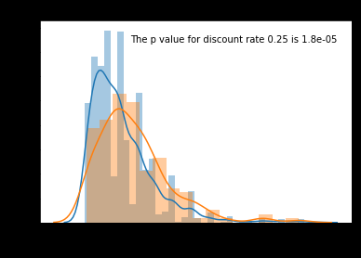
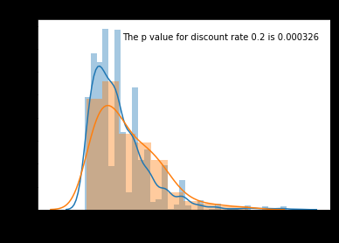
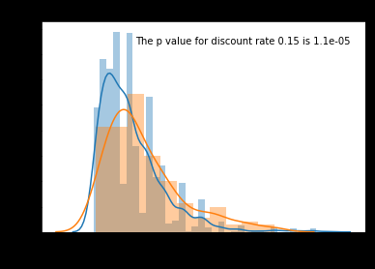
Histograms of control (no discount) vs experimentals
As you can see, each level of discount was significant for alpha=.05

Slide 7
Effect Sizes
Q2: How significant is the discount?
A1: We can use Cohen’s d to find the effect size given the mean, standard deviation and size of the control and each experimental group. All effect sizes were lower than .4, which means that while discounting did increase sales, it did not do so very much.

Slide 8
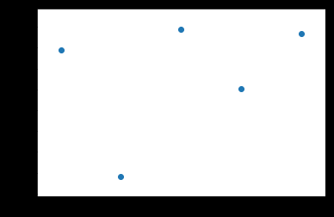
Business model
Q3: Is there a correlation between discount and effect size?
A1: No, this scatterplot appears utterly random.
What this means is that a low discount of 5% is just as good at boosting sales as any higher discount.

Slide 9
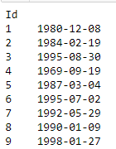
Is there a relationship between sales and age?
The employee group was split into an older and younger group (the cutoff being the year 1990). Statistics showed that both groups performed the same sales-wise, meaning experience did not scale with age.

Slide 10

Does a PhD improve sales potential?
One employee has a doctorate while the rest do not. Does this employee perform statistically better in marketing?
Again, no. Statistics showed that advanced degrees do not increase sales potential.

